Slide 1
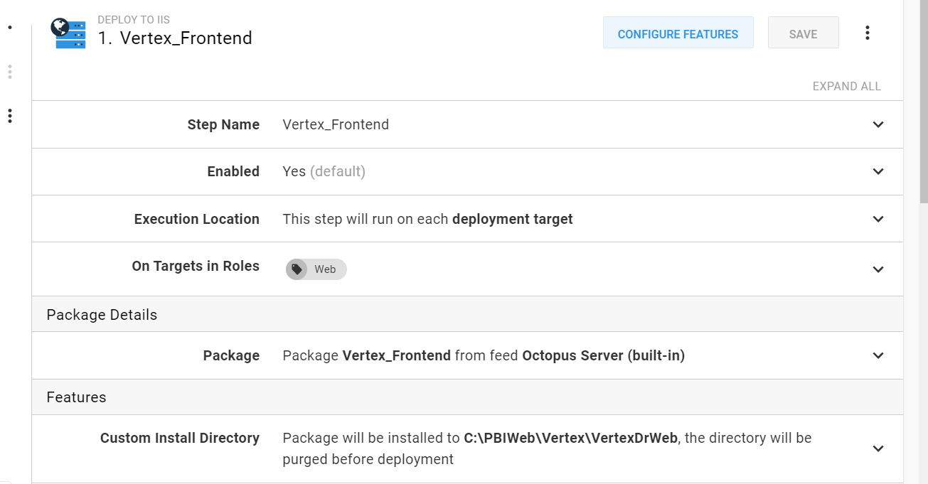

Slide 2
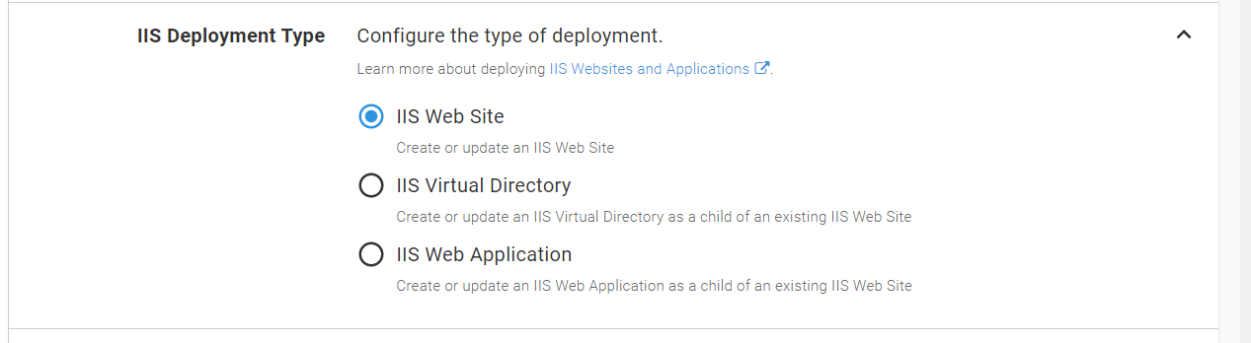

Slide 3
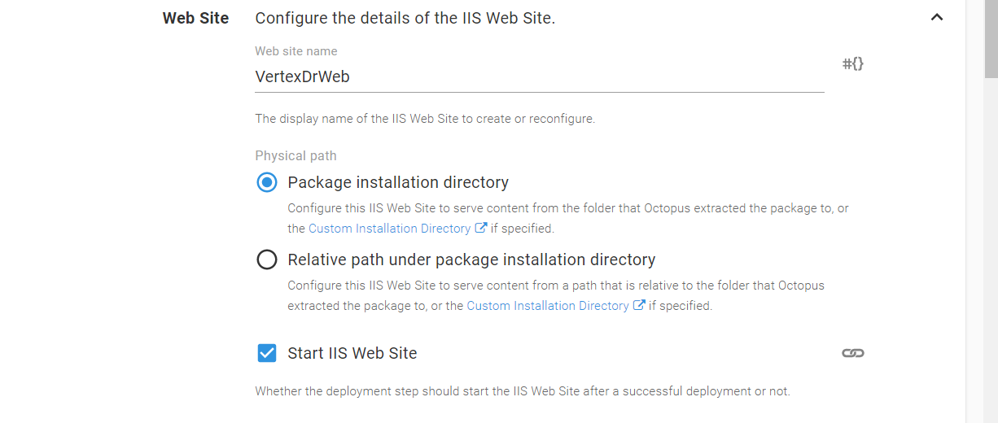

Slide 4
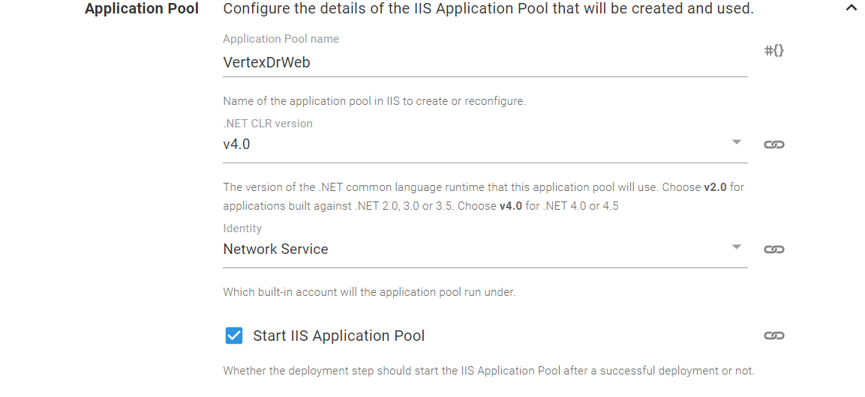

Slide 5
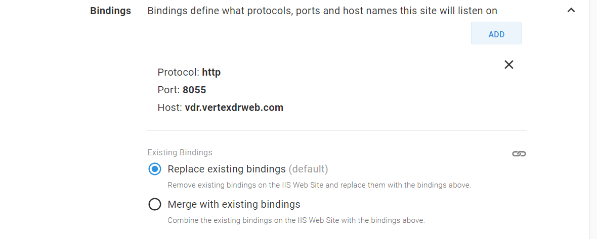

Slide 6
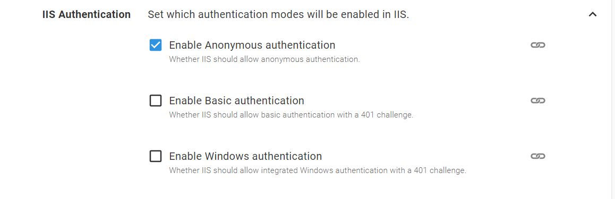

Slide 7
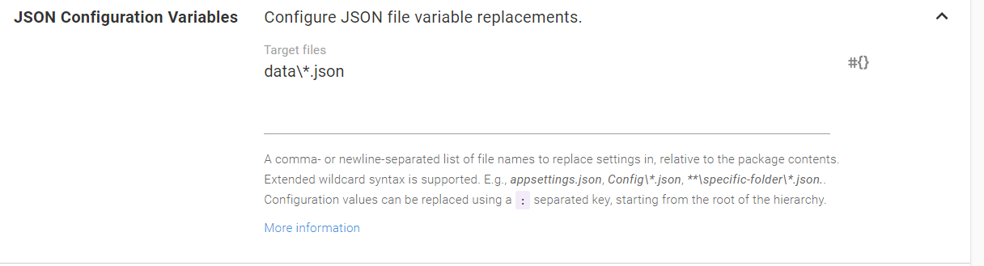

Slide 8
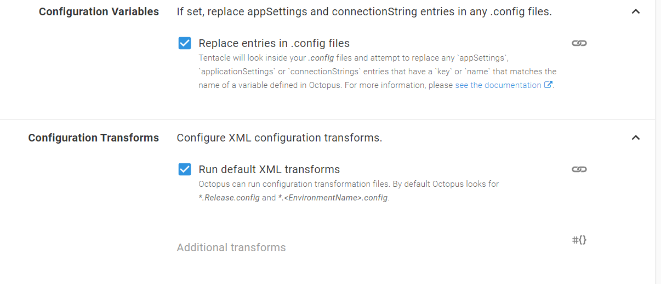

Slide 9
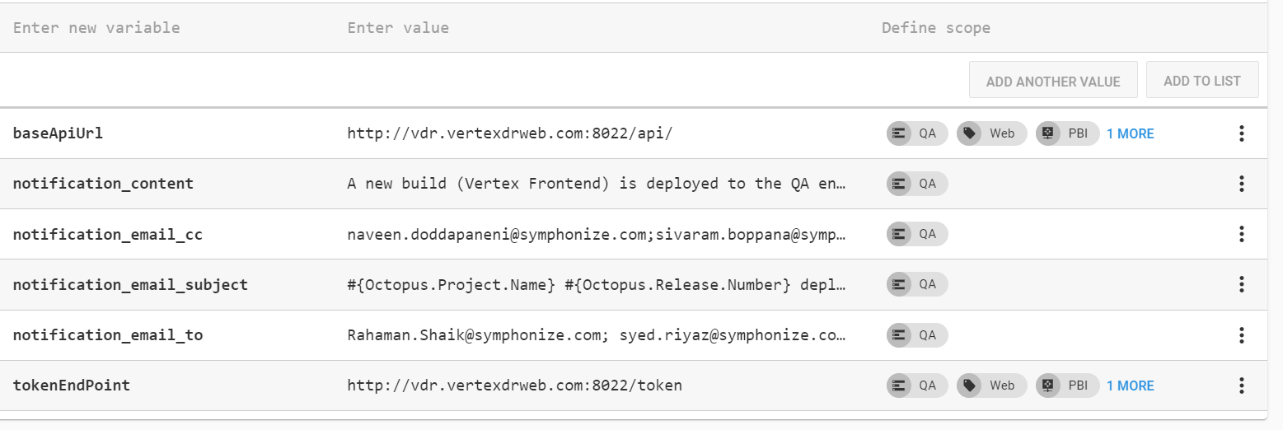

Slide 10
Variables
baseApiUrl http://vdr.vertexdrweb.com:8022/api/
tokenEndPoint http://vdr.vertexdrweb.com:8022/token
notification_content : A new build (Vertex Frontend) is deployed to the QA environment
notification_email_cc : naveen.doddapaneni@symphonize.com;sivaram.boppana@symphonize.com;sridhar@symphonize.com;ashok@symphonize.com
notification_email_subject : #{Octopus.Project.Name} #{Octopus.Release.Number} deployed to #{Octopus.Environment.Name}
notification_email_to : Rahaman.Shaik@symphonize.com; syed.riyaz@symphonize.com; Yogita.Karangula@symphonize.com; rajani.ponnam@symphonize.com; suresh.dasari@symphonize.com; sudheer.ghanta@symphonize.com; nikesh.gurijala@symphonize.com; kshutritha.kanna@symphonize.com; vijay.jupudi@symphonize.com; afroz.mohammed@symphonize.com; neha.sharma@symphonize.com; kedarnath.ragam@symphonize.com; praveen.saga@symphonize.com

Slide 11
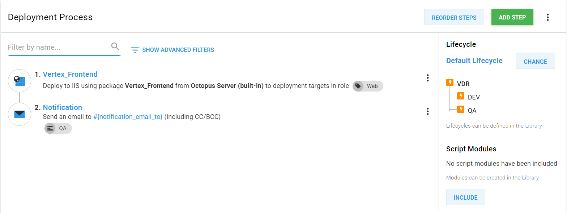

Slide 12
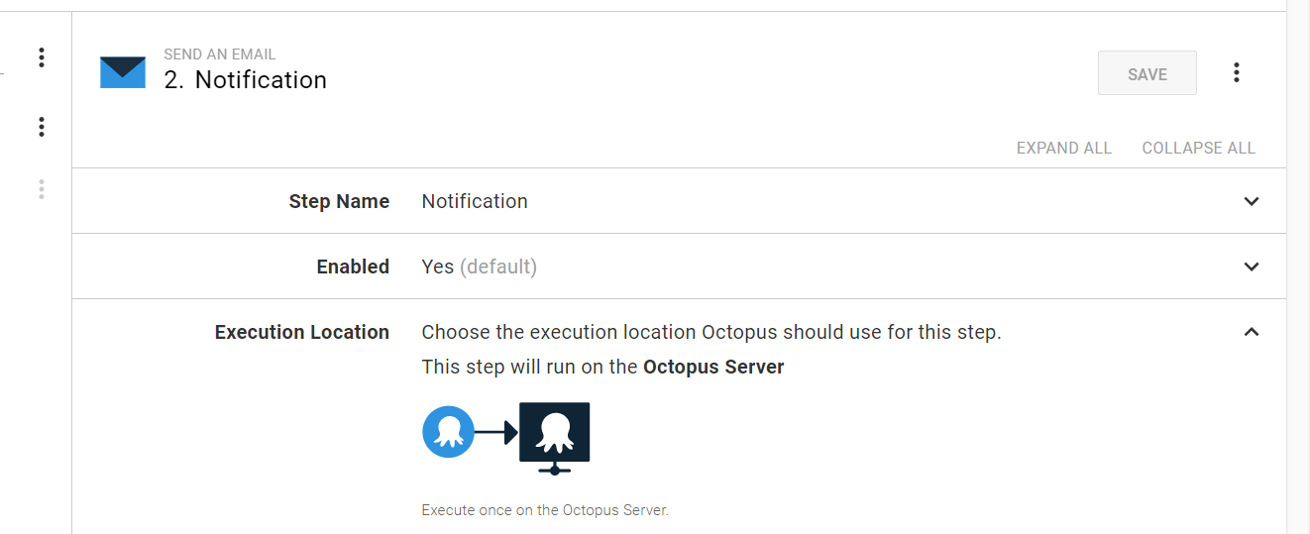

Slide 13
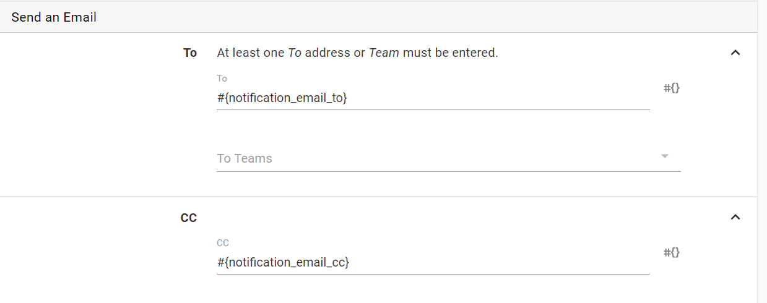

Slide 14
